Slide 1

EMERGING TRENDS, TECHNOLOGIES, AND APPLICATIONS
Dr. Ghulam Mujtaba
Postdoc Researcher
West Virginia University, WV, USA
Dec 21, 2023

Slide 2
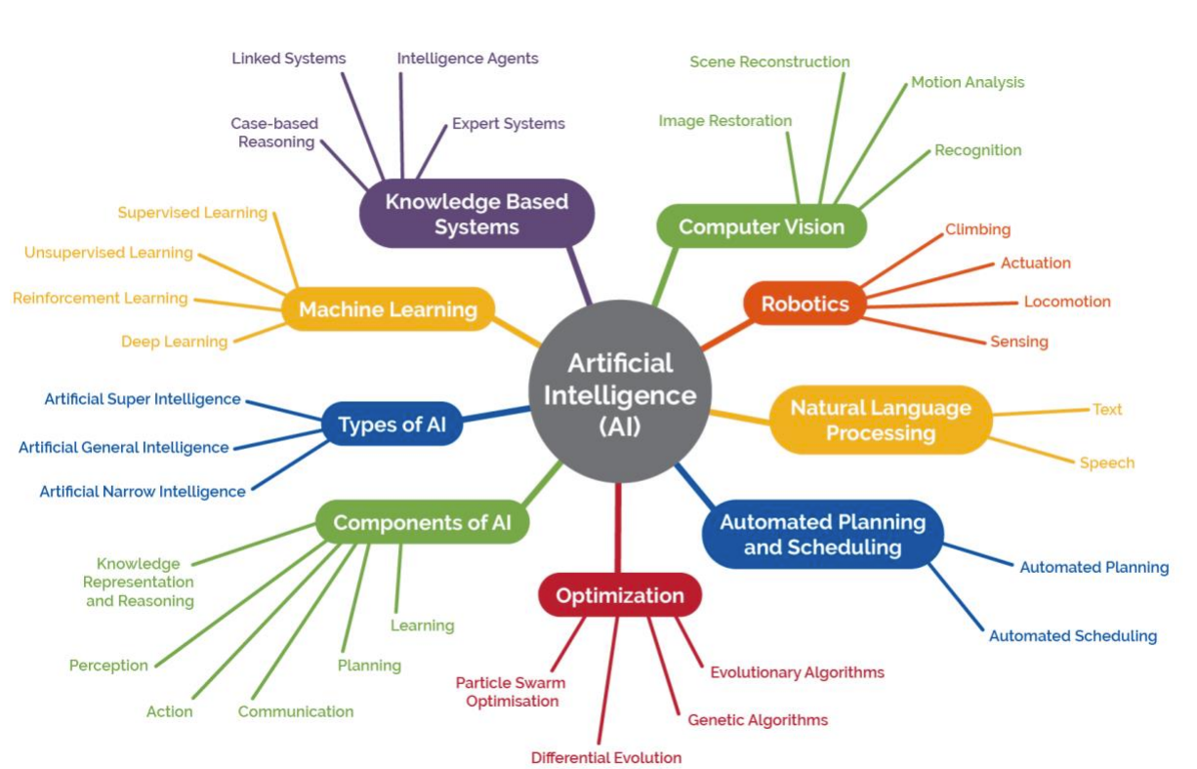
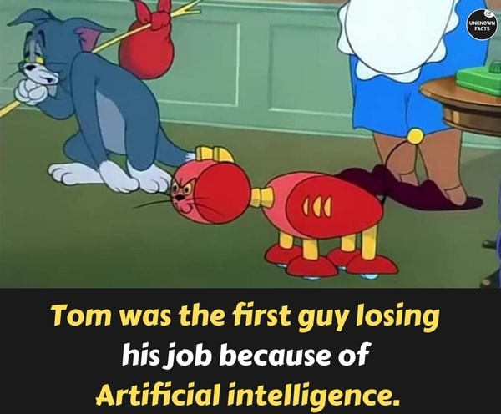
Artificial Intelligence (AI)
AI refers to the ability of a computer or robot to mimic human intelligence. It could cover, for example, computers that analyse data independently or the autonomous systems embedded in driverless vehicles.
AI thrives in an environment where there are defined rules and patterns that it can work with. This is where AI will seem the most “Intelligent”.

Slide 3
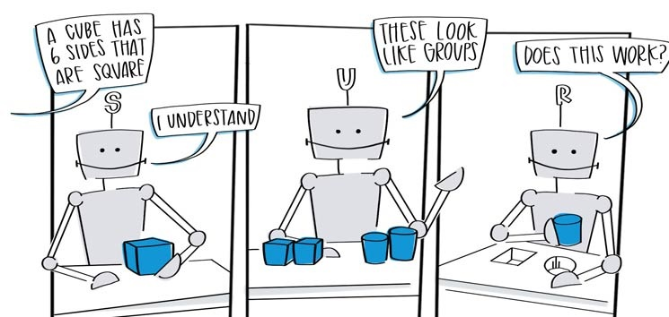
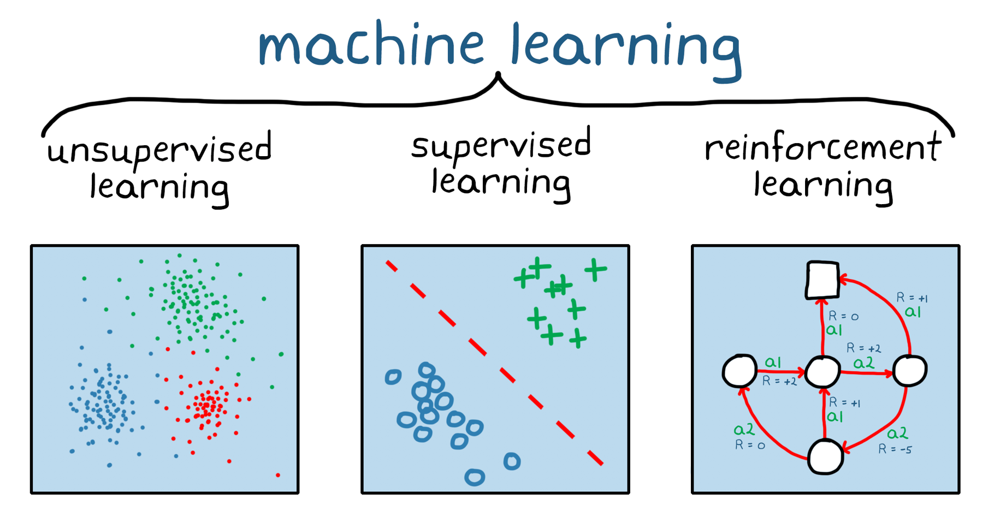
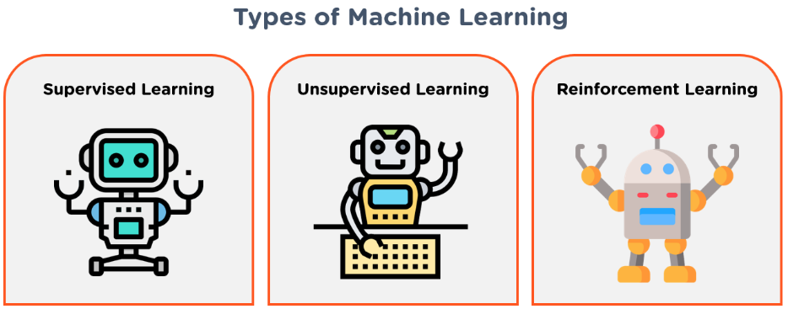
Machine Learning (ML)
Machine learning is a subfield of artificial intelligence, which is broadly defined as the capability of a machine to imitate intelligent human behavior. Artificial intelligence systems are used to perform complex tasks in a way that is similar to how humans solve problems.

Slide 4
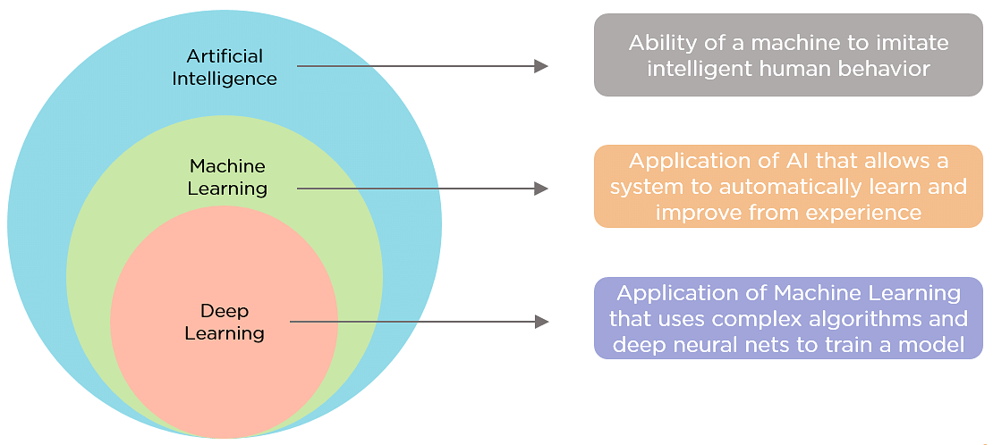
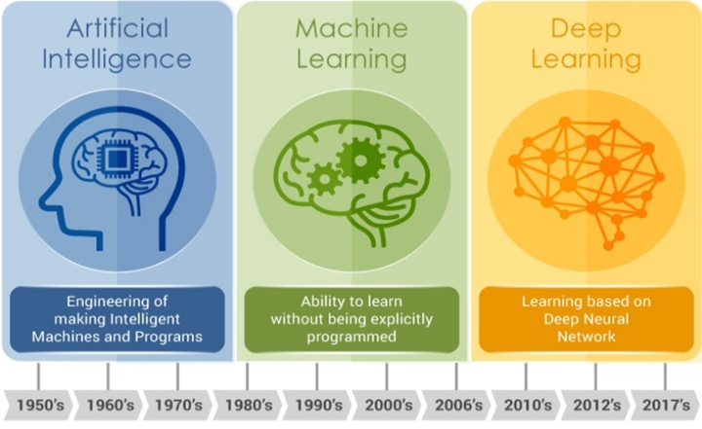
Deep Learning (DL)
Deep learning: DL is a subset of machine learning. With this model, an algorithm can determine whether or not a prediction is accurate through a neural network without human intervention. Deep learning models can build extensive knowledge over time, acting as a brain, of sorts.

Slide 5
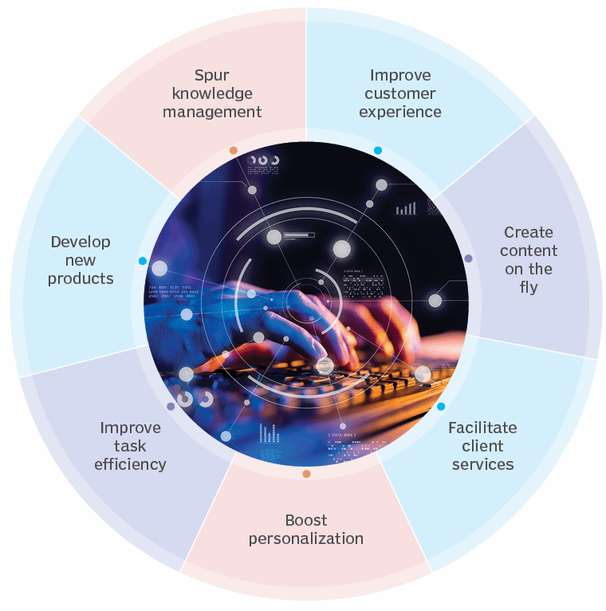
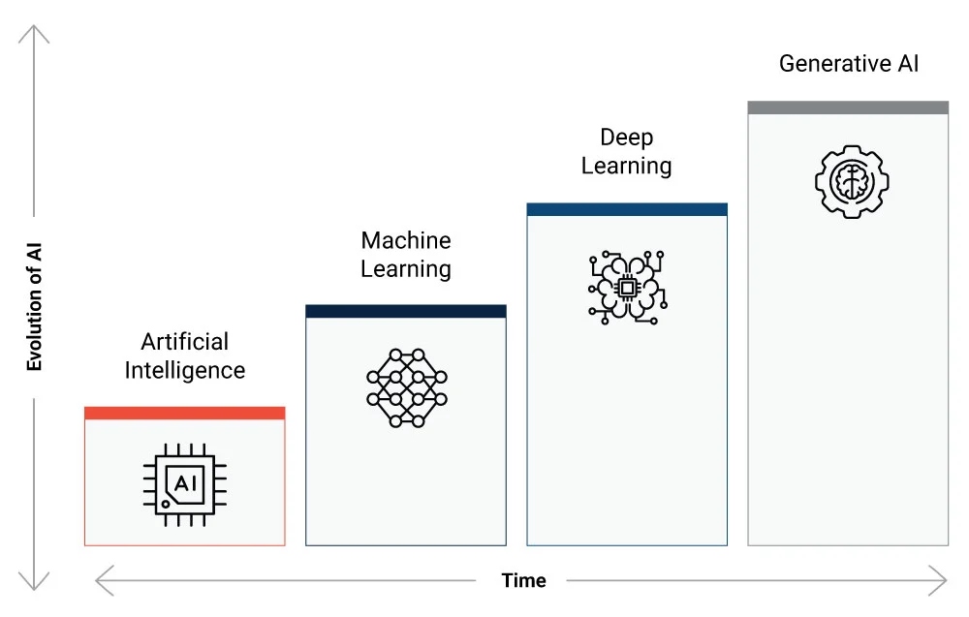
Generative AI (GAI)
Generative AI focuses on creating new and original content, chat responses, designs, synthetic data or even deepfakes.

Slide 6
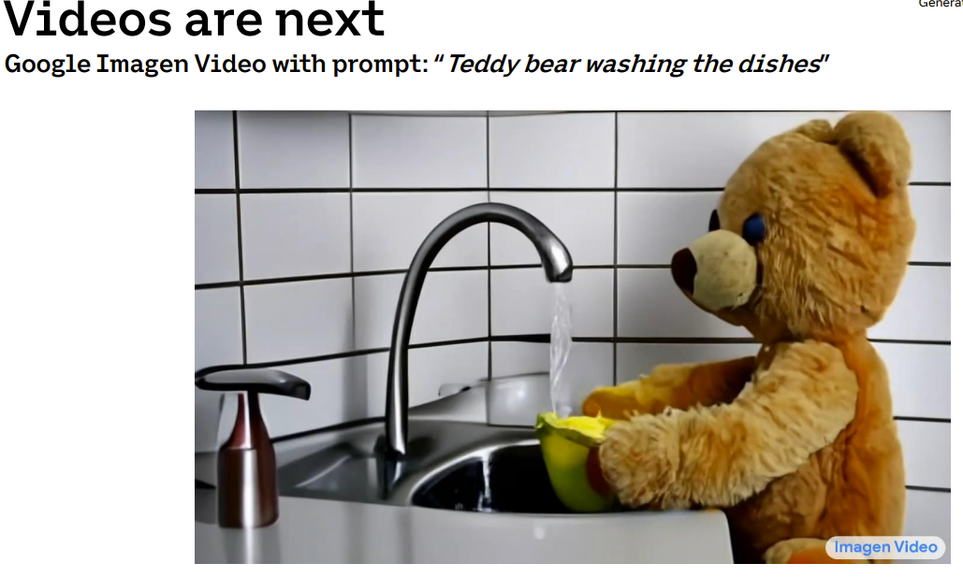
Generative Artificial Intelligence (GAI)
Technology that uses algorithms and machine learning to create new content (text, photos, video, audio, etc.)
Examples of AI software*:
ChatGPT/OpenAI
Socratic
AirMath
Nerdy Bot
Grammarly
OddityAI
* Not all inclusive

Slide 7
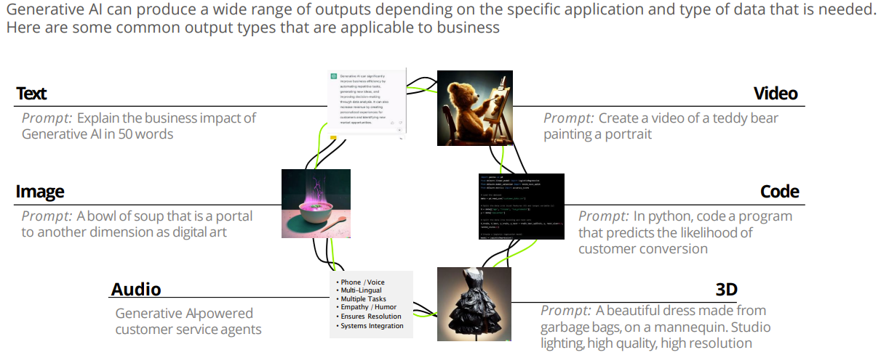
GAI’s Capabilities

Slide 8

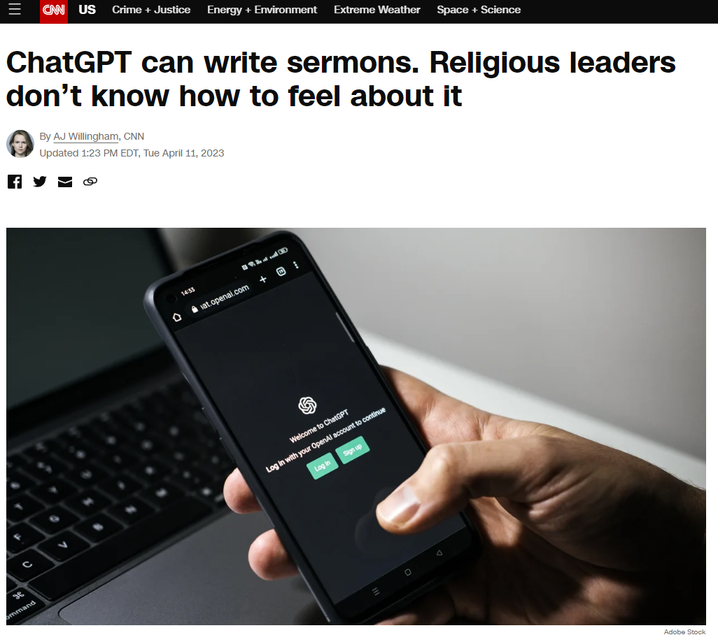

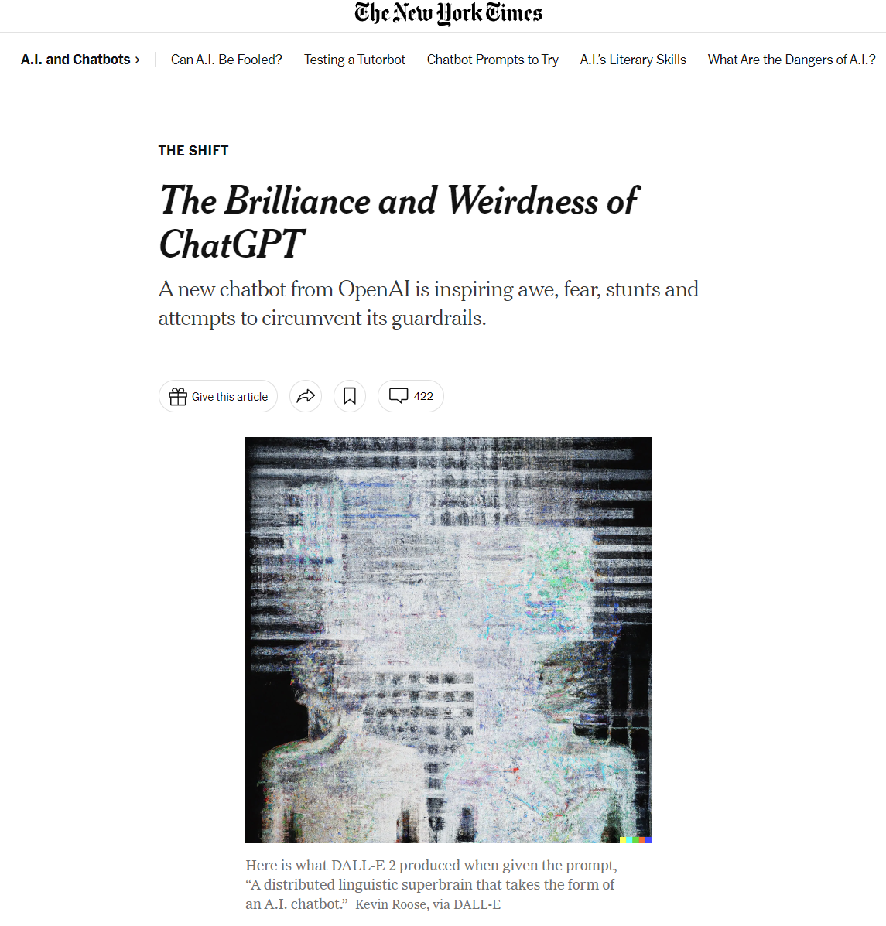
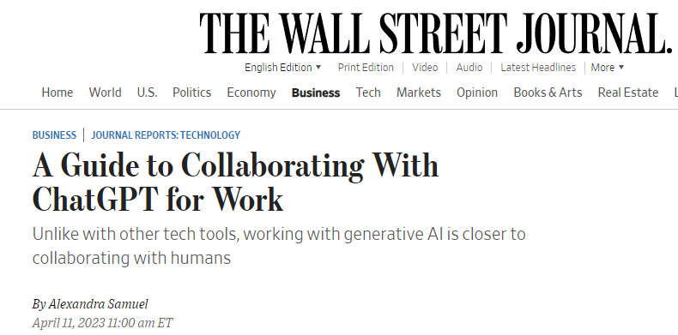
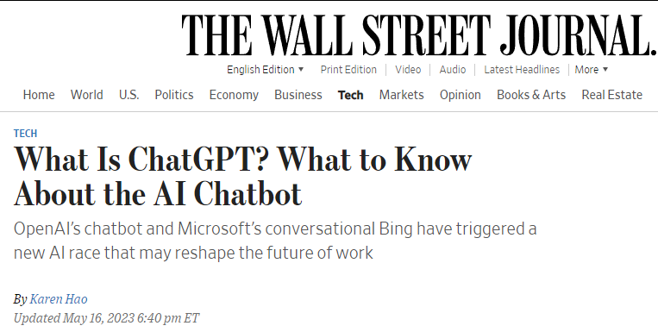
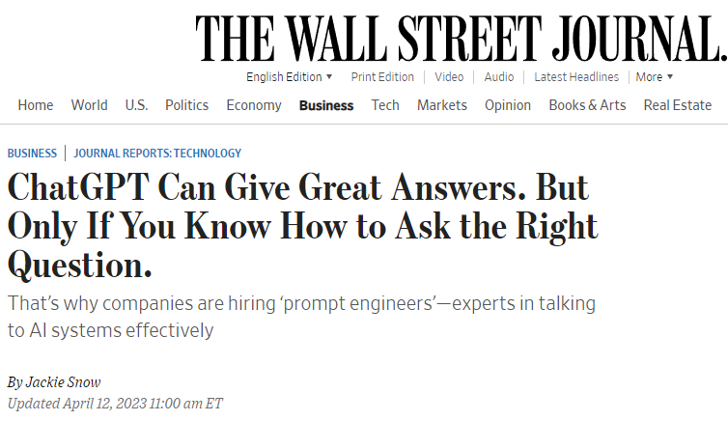
Large Language Models: ChatGPT, Bard, Claude, DALL-E, …

Slide 9
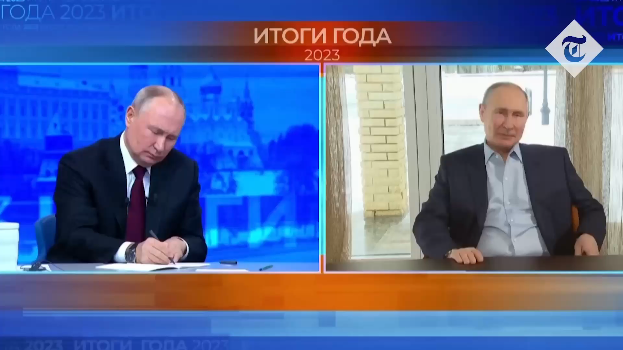
Generative AI: Deepfake

Slide 10
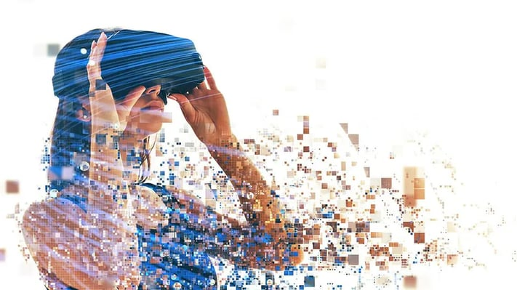
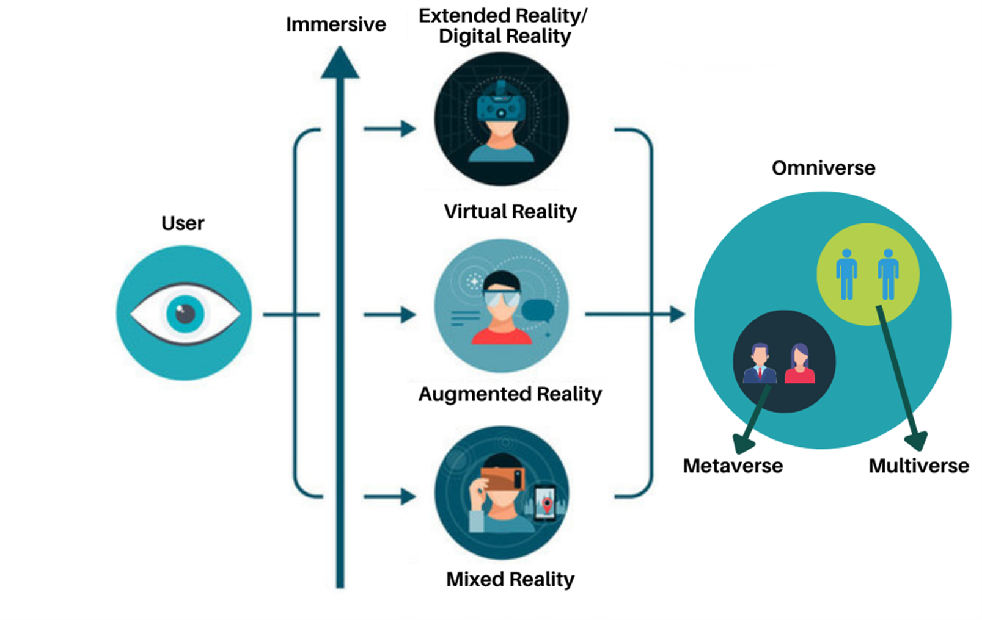
Immersive Technologies
The concept of immersive technology is not new and first appeared around 50 years ago when the first immersive human-computer interaction prototype “Man-Machine Graphical Communication system” was built.
Immersive Extended reality technology is used as a term that describes virtual reality (VR), augmented reality (AR) mixed reality (MR), and eXtended reality (XR) technologies as a whole.

Slide 11
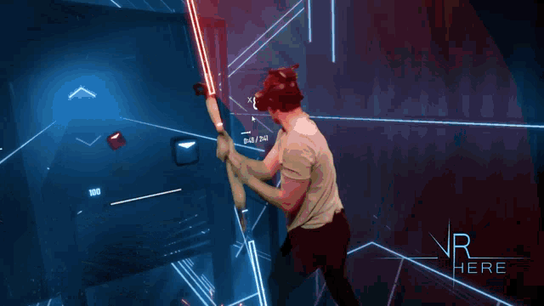
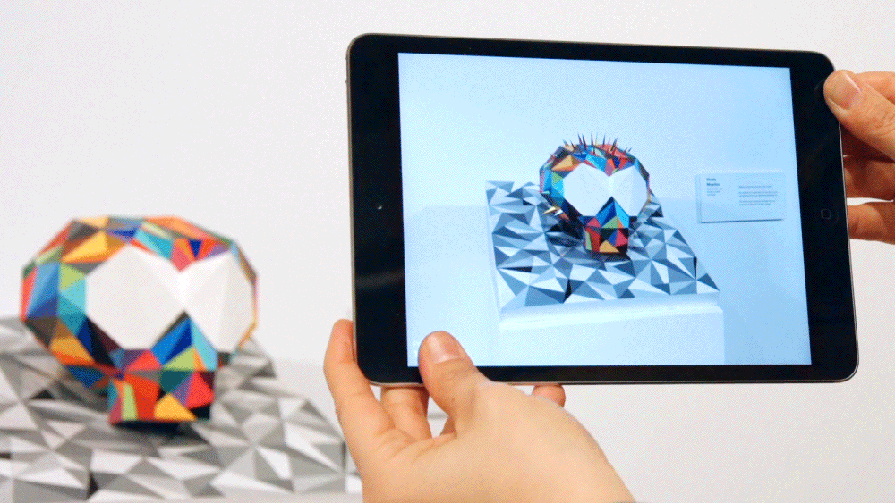
Immersive Technologies
Virtual Reality (VR) is an interactive computer-generated experience taking place within a simulated environment.
Augmented reality (AR) is an interactive experience of a real-world environment where the objects that reside in the real-world are "augmented" by computer-generated perceptual information

Slide 12
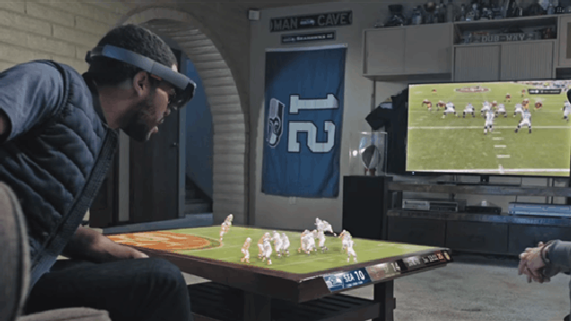
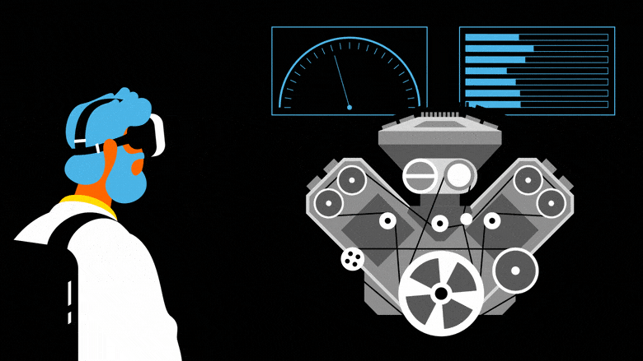
Immersive Technologies
Mixed reality (MR), or hybrid reality, is the
merging of real and virtual worlds to produce new
environments and visualizations where physical
and digital objects co-exist and interact in real
time
Extended reality (XR) is a universal term inclusive to immersive learning technologies virtual reality (VR), augmented reality (AR), and mixed reality (MR).
Mixed Reality (MR)
Real Environment Augmented Reality Augmented Virtuality Virtual Environment
(Reality- virtuality continuum (Milgram & Kishino, 1994)*

Slide 13
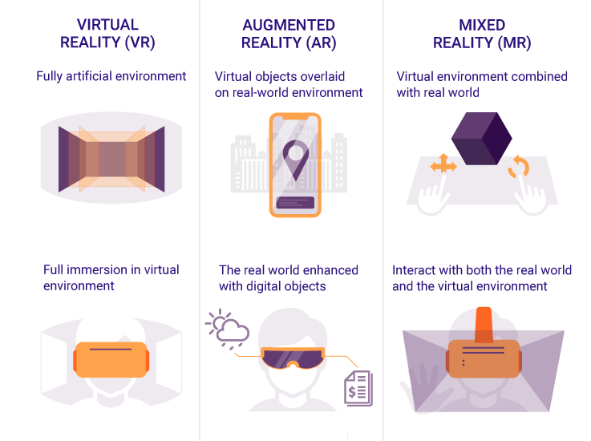
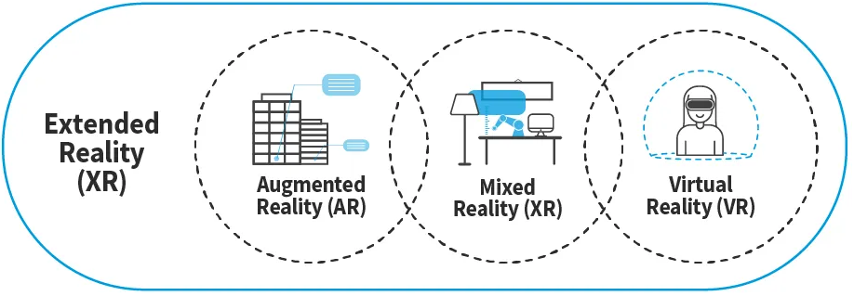
Immersive Technologies

Slide 14

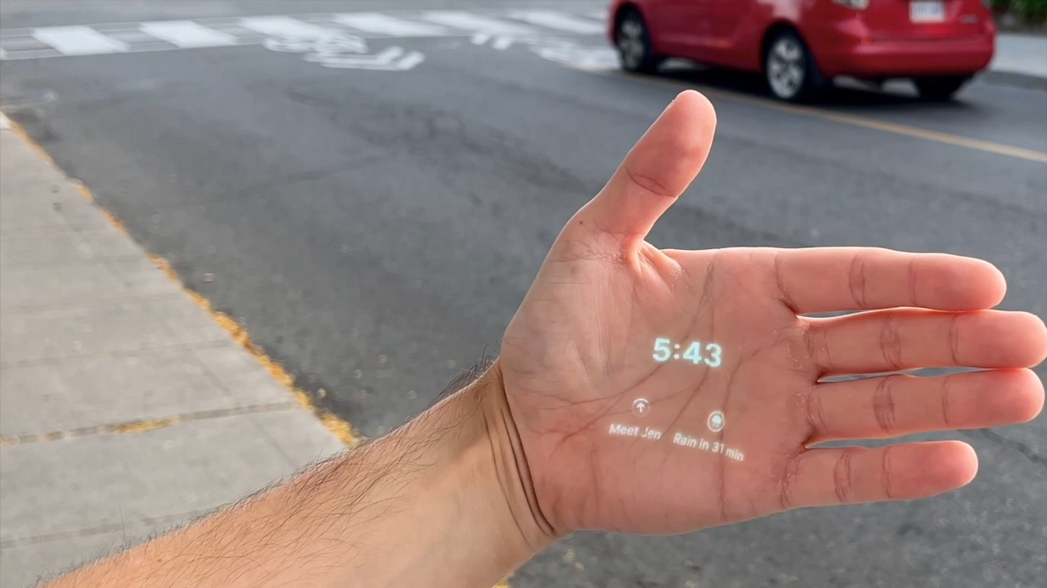
Example: AI-PIN

Slide 15
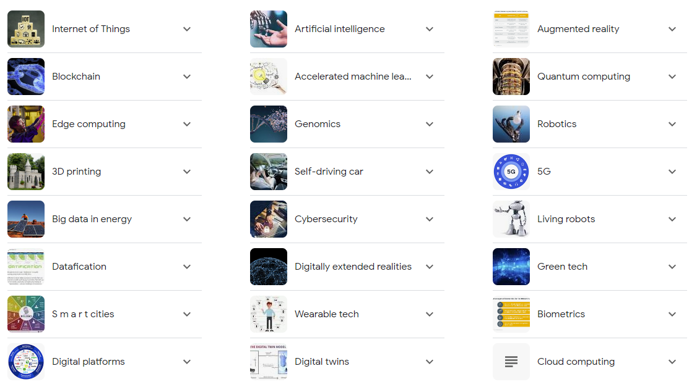
Other Technologies
Advanced Computing
Supercomputing
Edge computing
Cloud computing
Data storage
Computing architectures
Data processing and analysis techniques
Renewable Energy Generation and Storage
Renewable generation
Renewable and sustainable fuels
Energy storage
Electric and hybrid engines
Batteries
Grid integration technologies
Energy-efficiency technologies
Quantum Information Technologies
Quantum computing
Materials, isotopes, and fabrication techniques for quantum devices
Post-quantum cryptography
Quantum sensing
Quantum networking
*and many many more

Slide 16

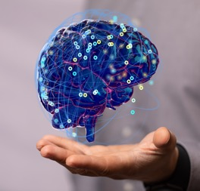
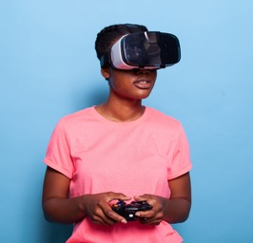

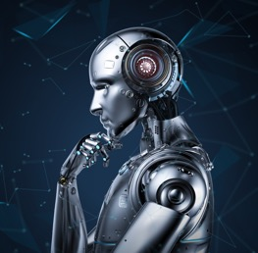
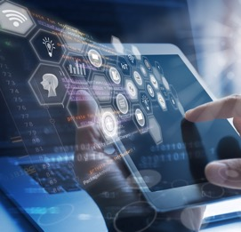
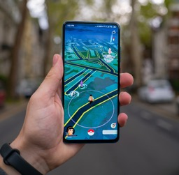




Innovations that will shape the future
QR Scan
Artificial intelligence (AI)
Virtual reality (VR)
Robotics
@iamgmujtaba
@iamgmujtaba
Internet of things (IoT)
Augmented reality (AR)
gmujtabakorai@gmail.com

